Slide 1
Determining Skeletal Age Using Deep Learning
GUIDE : Dr. Sanjay Chitnis
(Chairman, Dept. of CSE)
CO-GUIDE: Prof. Shwetha G S
(Assistant Professor, Dept of CSE)
Group 13
Abhay Shastry | ENG18CS0008
Antonio Mervyn | ENG18CS0056
Binish Zehra Rizvi | ENG18CS0060
Varun Menon | ENG18CS0314

Slide 2
Introduction
A Skeletal bone age assessment is a procedure used in pediatric radiology for both diagnostic and therapeutic investigations of endocrinology problems, children growth and genetic disorders.
It is usually performed by radiological examination of the left hand, because of the discriminant nature of bone ossification stages of the non-dominant hand, and then compared to chronological age: a discrepancy between the two values indicates abnormalities.

Slide 3
Tanner-Whitehouse method
The Tanner-Whitehouse (TW) method is a way of assessing the bone age of children. There are several variations of this method, but all use a radiograph of the left hand and wrist to assess the relative maturity of the bones of the patient.
The TW2 (Tanner-Whitehouse 2) methods:
RUS (radius-ulna-short bones): 13 bones including the radius, ulna and short bones of the thumb, middle and little fingers
carpus: 7 carpal bones
20-bones method: combines the two

Slide 4
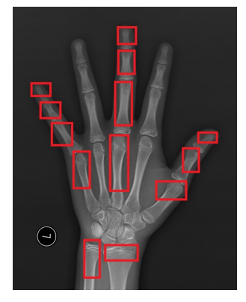
Tanner-Whitehouse method
Each of the bones that is being evaluated is compared to a standard set of bones at different stages of maturation. A score is assigned to each bone based on maturation and sex of the patient.
Once all the bones have been scored, a total score is generated by adding all bone scores together and then plotted on a graph to determine how the bone age relates to the chronological age.

Slide 5
Problem Statement
Traditional bone age assessment methods normally require doctors to physically examine the x-ray with reference to a huge dataset of x rays to look for even the smallest discrepancies
This is a very tedious task that requires a huge amount of time by the doctor
If we can find a solution to this problem, we can free up the time taken by doctors so that they can attend more pressing matters

Slide 6
Solution
Since we have established the tedium associated with traditional methods of bone age assessment, it is clear that we need to find a solution to this using technological advancements.
This is where Neural networks come into play where we use artificial neural networks in the form of a modified CNN in order to create an application that quickly and efficiently assess bone age
To sum it up, Deep Learning on Determining Skeletal Age will help the doctors in the medical field to predict the bone age of the patients in a relatively short amount of time and provide an accurate result, minimizing physical errors.

Slide 7
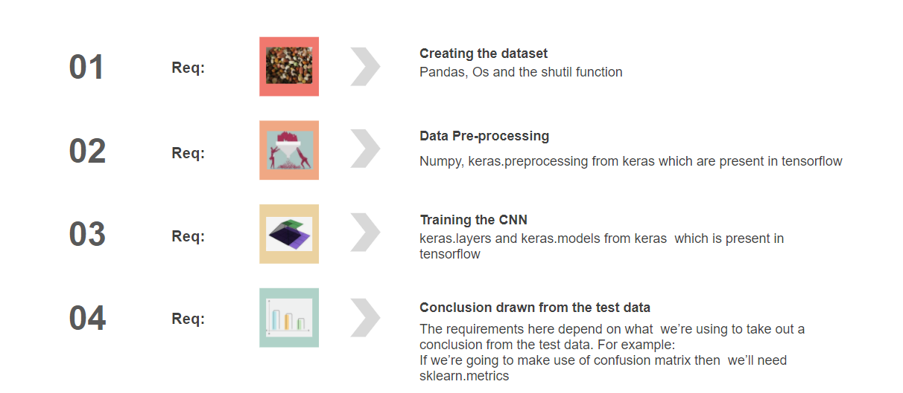
Data Flow

Slide 8
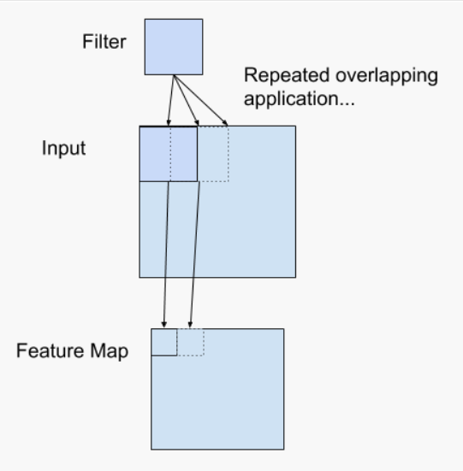
Typical CNN
A convolutional neural network (CNN) is a type of artificial neural network used in image recognition and processing that is specifically designed to process pixel data.
Convolutional neural networks apply a filter to an input to create a feature map that summarizes the presence of detected features in the input.

Slide 9
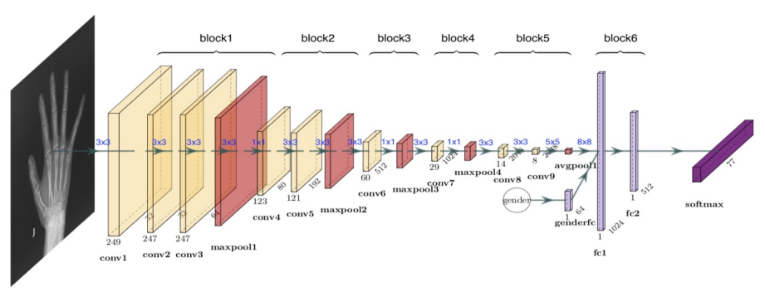
Typical CNN

Slide 10
INCEPTION
Inception Layer is a combination of all those layers (namely, 1×1 Convolutional layer, 3×3 Convolutional layer, 5×5 Convolutional layer) with their output filter banks concatenated into a single output vector forming the input of the next stage.

Slide 11
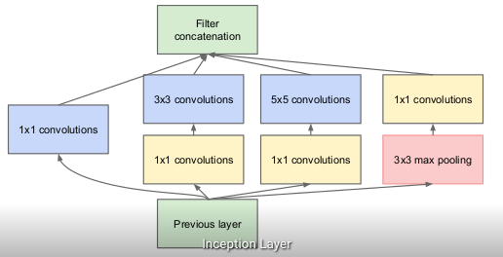
INCEPTION

Slide 12
XCEPTION
Xception by Google, stands for Extreme version of Inception, is reviewed. With a modified depthwise separable convolution, it is even better than Inception-v3
It’s main difference lies in the fact that normal convolution is replaced by a concept called Depthwise Separable Convolution
Another difference lies in the fact that the non linearity is not immediately established as we go into the input layer

Slide 13
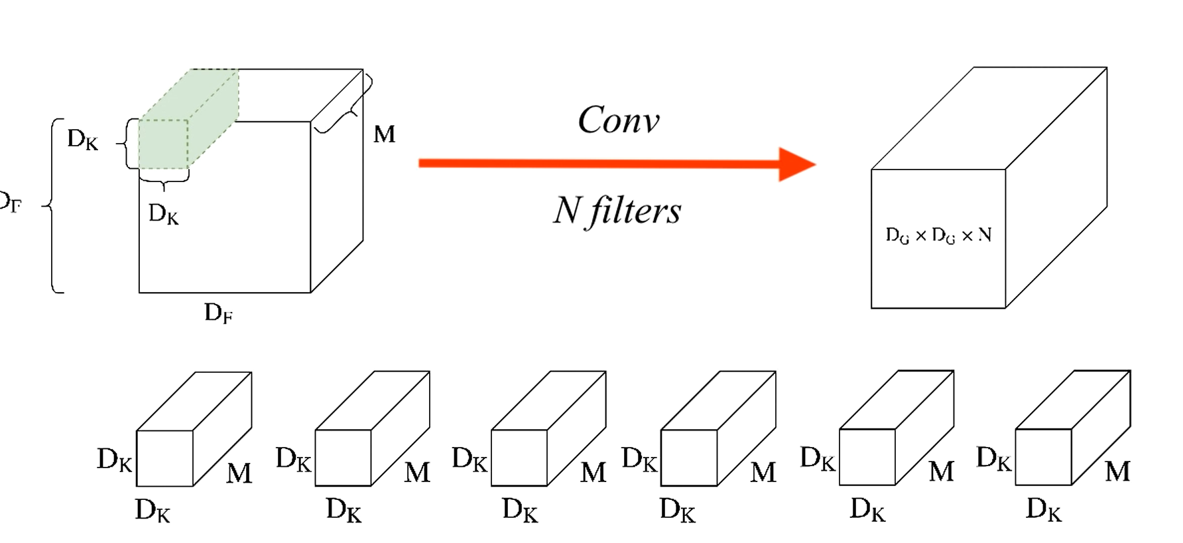

Slide 14
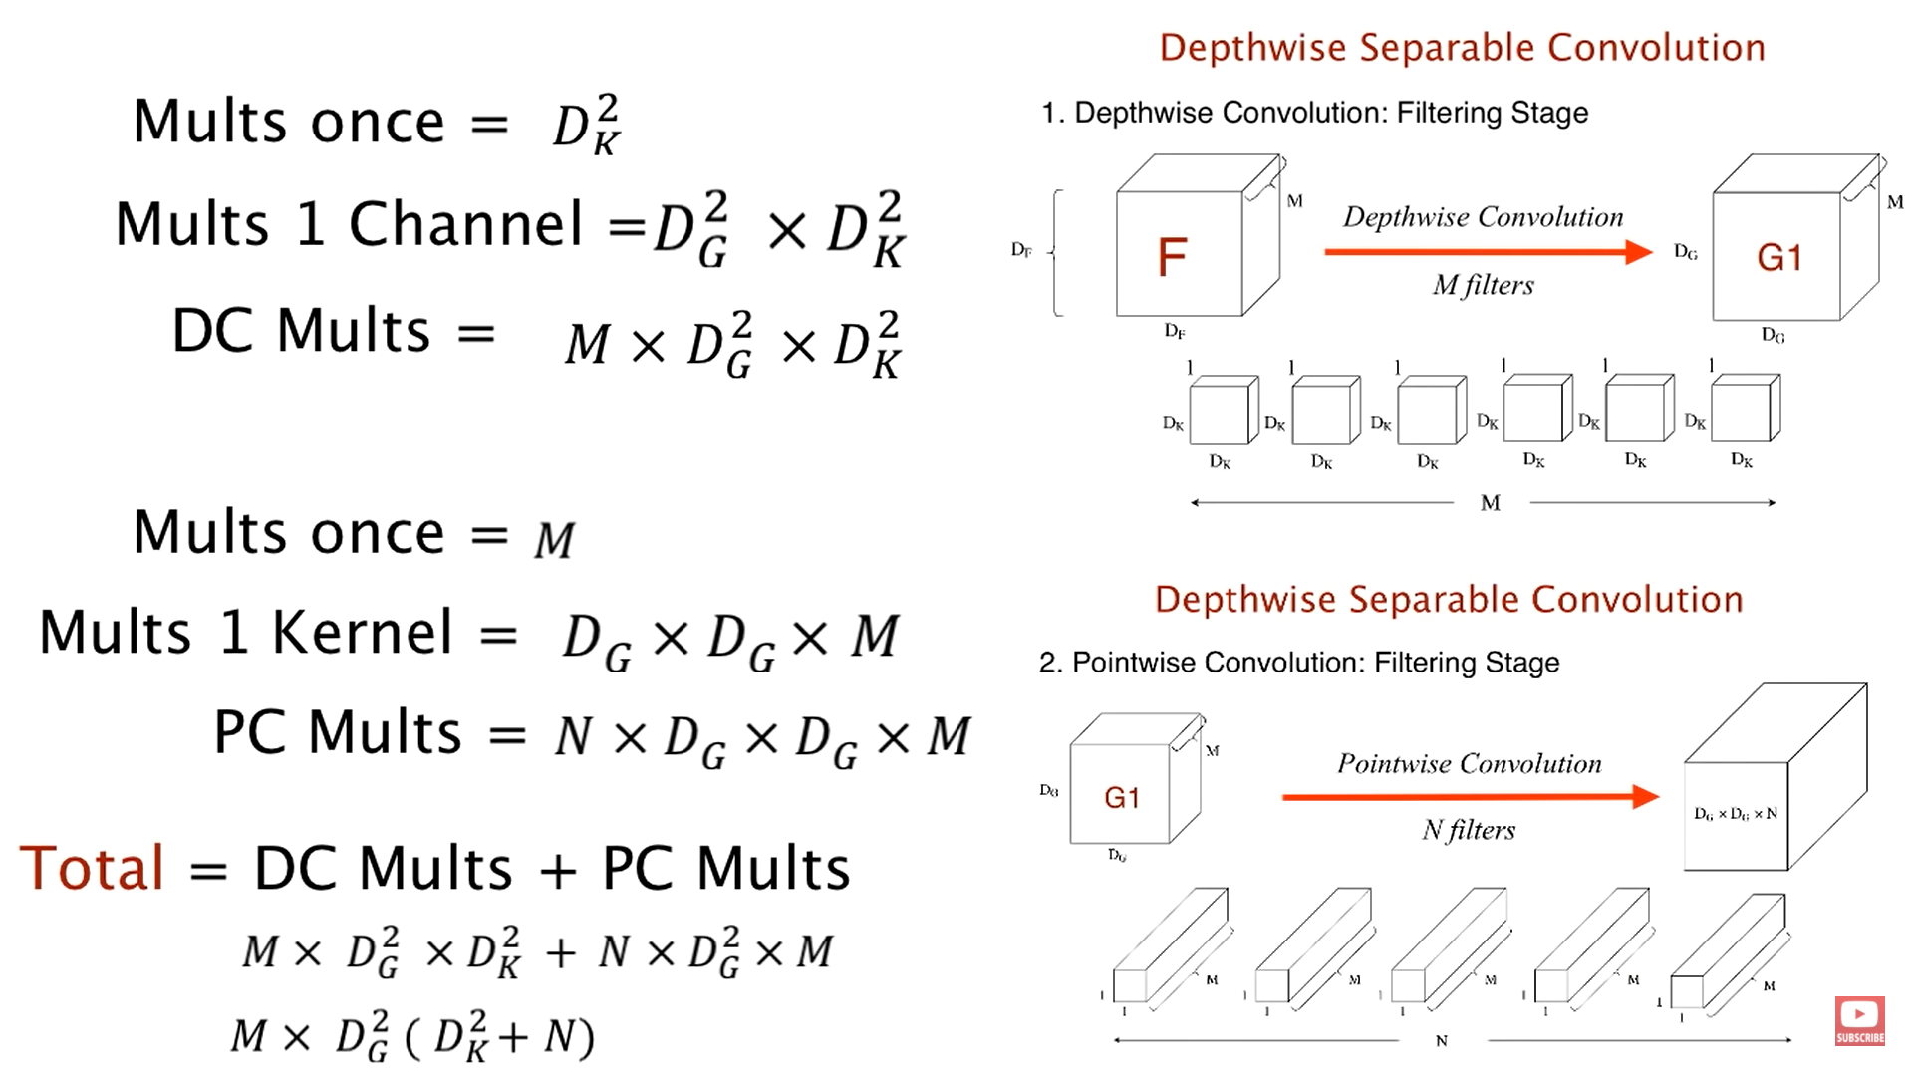

Slide 15
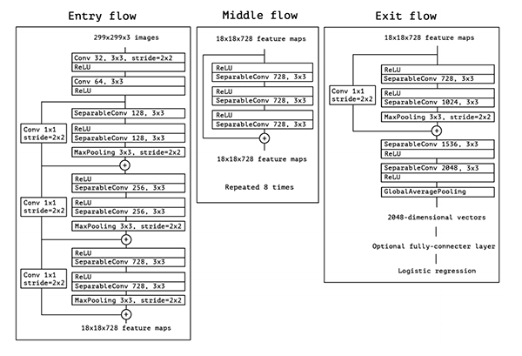

Slide 16
Activation
Function
It’s just a thing function that you use to get the output of node. It is also known as Transfer Function.
It is used to determine the output of neural network like yes or no. It maps the resulting values in between 0 to 1 or -1 to 1 etc. (depending upon the function).

Slide 17
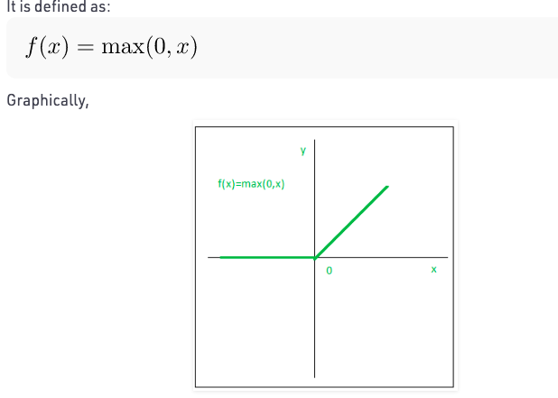
ReLU
The ReLU function is the Rectified linear unit. It is the most widely used activation function. It is defined as:
The main advantage of using the ReLU function over other activation functions is that it does not activate all the neurons at the same time.

Slide 18
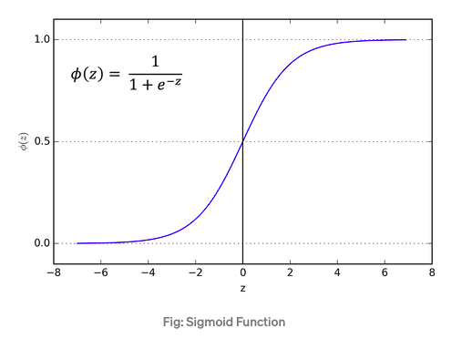
Sigmoid
Sigmoid function is a widely used activation function. It is defined as
The main reason why we use sigmoid function is because it exists between (0 to 1). Therefore, it is especially used for models where we have to predict the probability as an output.Since probability of anything exists only between the range of 0 and 1, sigmoid is the right choice.

Slide 19
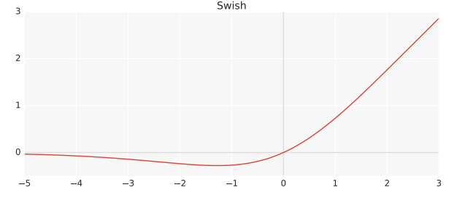
Swish
Swish is essentially a modified sigmoid function which is simply f(x) = x · sigmoid(x). Experiments show that Swish tends to work better than ReLU on deeper models across a number of challenging data sets..
Swish is a smooth, non-monotonic function that consistently matches or outperforms ReLU on deep networks applied to a variety of challenging domains such as Image classification and Machine translation.

Slide 20
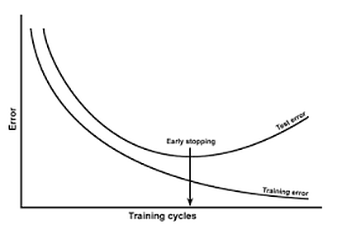
Overfitting
Overfitting occurs when our model becomes really good at being able to classify or predict on data that was included in the training set, but is not as good at classifying data that it wasn't trained on. So essentially, the model has overfit the data in the training set.

Slide 21
How Are We Avoiding Overfitting?
We are using 2 functions to prevent overfitting our model:
EarlyStopping
ReduceLROnPlateau

Slide 22
EarlyStopping
Stop training when a monitored metric has stopped improving.
Assuming the goal of a training is to minimize the loss. With this, the metric to be monitored would be 'loss', and mode would be 'min'. A model.fit() training loop will check at end of every epoch whether the loss is no longer decreasing, considering the min_delta and patience if applicable. Once it's found no longer decreasing, model.stop_training is marked True and the training terminates.

Slide 23
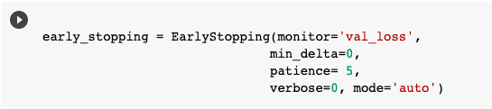
EarlyStopping
Implementation of EarlyStopping

Slide 24
ReduceLROnPlateau
Reduce learning rate when a metric has stopped improving.
Models often benefit from reducing the learning rate by a factor of 0-10 once learning stagnates. This callback monitors a quantity and if no improvement is seen for a 'patience' number of epochs, the learning rate is reduced.

Slide 25
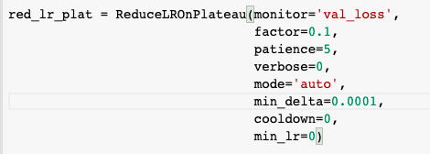
ReduceLROnPlateau
Implementation of ReduceLROnPlateau

Slide 26
Final Model
Now that we have looked at different aspects of Deep Learning Neural networks, Convolution Neural Network to be specific, we can basically take the best possible algorithms, equations and models to combine them to form a completely new model that is ideal for our task of bone age assessment
Our final model now basically consists of Xception as our architecture with Swish as the activation function that runs 5 epochs at 100 steps with a batch size of 32
We also made another model with ReLU to show the extent of difference between using swish rather than RelU

Slide 27
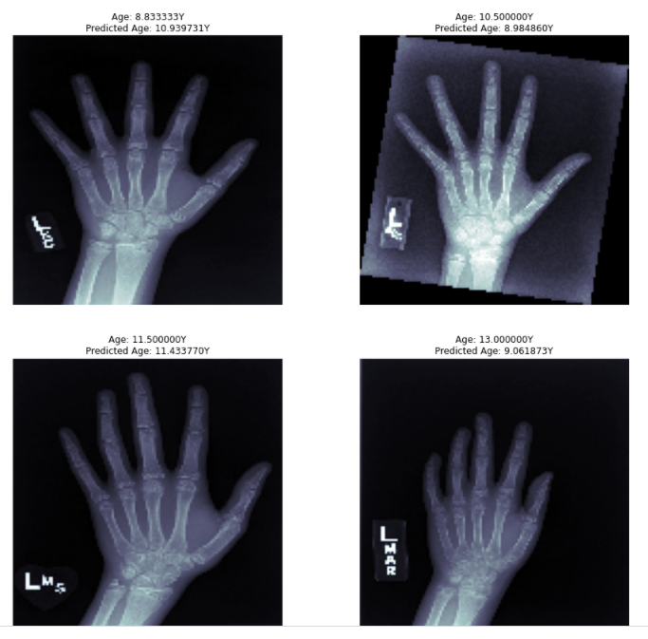
Output with RELU

Slide 28
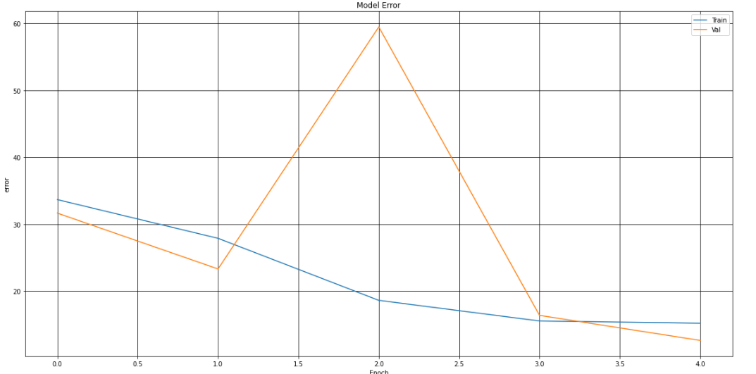
Model accuracy with ReLU

Slide 29
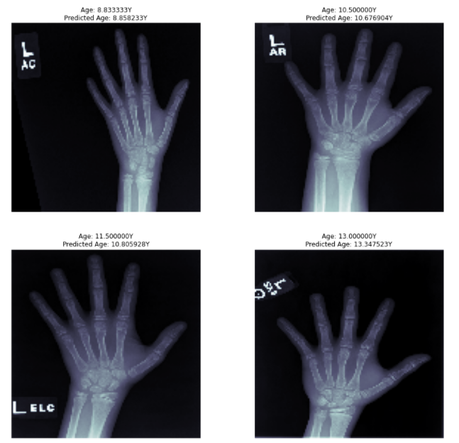
Output with swish

Slide 30
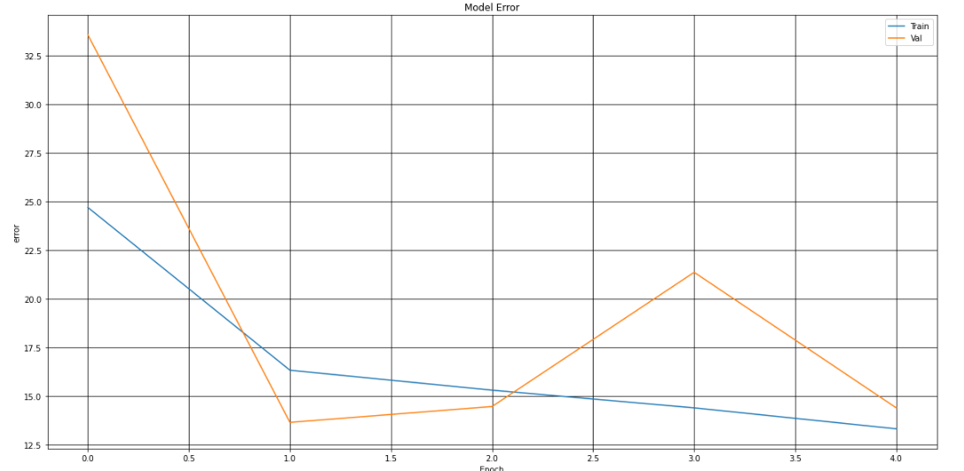
Model accuracy with SWISH

Slide 31
THANK YOU
GROUP 13
Abhay Shastry | ENG18CS0008
Antonio Mervyn | ENG18CS0056
Binish Zehra Rizvi | ENG18CS0060
Varun Menon | ENG18CS0314

